Slide 1
CSE 4128 Image Processing and Computer Vision Laboratory Week 5: Region Descriptors and Feature Matching
Dr. Sk. Md. Masudul Ahsan
Professor
Dept. of CSE, KUET
Dipannita Biswas
Lecturer
Dept. of CSE, KUET

Slide 2
Region Descriptors
Information that lets you recognize a region.
They focus on the content and texture of objects in an image.
They describe the distribution of pixel values within a region and capture the spatial relationships between different regions.
They extract relevant information from the image and represent it in a way that can be easily compared and matched with other images.

Slide 3
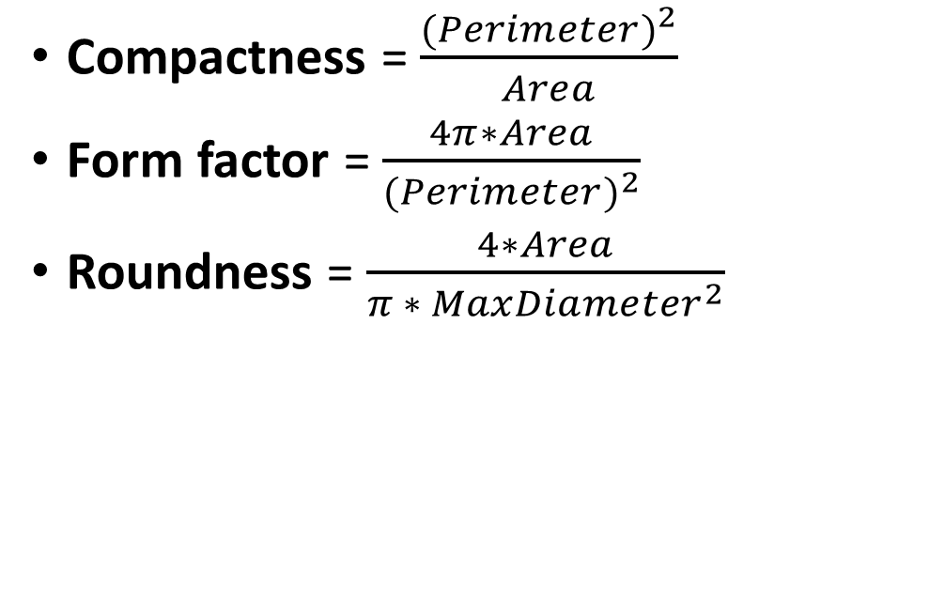
Region Descriptors
Compactness = $\frac{{(Perimeter)}^{2}}{Area}$
Form factor = $\frac{4π∗Area}{{(Perimeter)}^{2}}$
Roundness = $\frac{4∗Area}{π ∗ {MaxDiameter}^{2}}$

Slide 4



Example
Form factor
Roundness
Compactness
0.1644
2.0132
76.426
0.1184
0.6075
106.097
0.1512
1.1469
83.118

Slide 5
Classwork
Take one of each shape as train image and the other as test image.
For each binary image:
Find the Boundary of the object in the image.
Apply erosion to the binary image.
Subtract the eroded image from the binary image to get the border of the region.
Calculate Perimeter, Area, Max Diameter of the region.
Use Area, Perimeter, and Max Diameter to calculate Form factor, Roundness, and Compactness and save it in a txt file.
Matching the descriptors of the test and train images to find close Match.

Slide 6
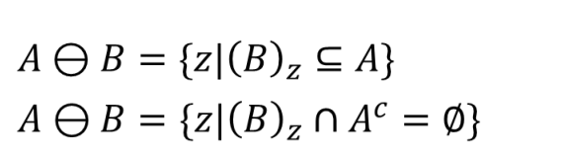

Erosion
1 | 1 | 1 | 1 | 1 | 1
1 | 1 | 0 | 0 | 1 | 1
1 | 0 | 0 | 0 | 0 | 1
1 | 1 | 0 | 0 | 1 | 1
1 | 1 | 1 | 1 | 1 | 1
0 | 0 | 0 | 0 | 0 | 0
1 | 0 | 0 | 0 | 0 | 1
1 | 0 | 0 | 0 | 0 | 1
1 | 0 | 0 | 0 | 0 | 1
0 | 0 | 0 | 0 | 0 | 0
1
1
1

Slide 7
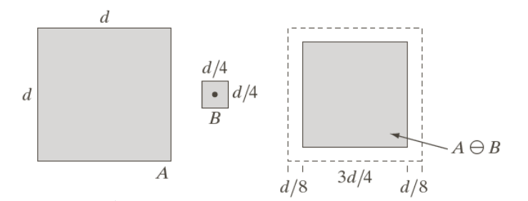
Erosion

Slide 8


Parameters
Area of a region is defined as the number of pixels in the region.
area = np.count_nonzero(binary_image)
Perimeter of a region is the length of its boundary.
perimeter = np.count_nonzero(border_image)

Slide 9
Parameters
MaxDiameter is considered here as the largest distance between the difference of leftmost, rightmost((x₂,y₂),(x₄,x₄))
and topmost, bottommost ((x₁,y₁),(x₃,x₃ )).
MaxDiameter =
maximum(x_{max-}x_{min ,} y_{max-} y_{min} )
(x1,y1)
x_{min}
(x2,y2)
(x4,y4)
x_{max}
(x3,y3)
y_{min}
y_{max}

Slide 10
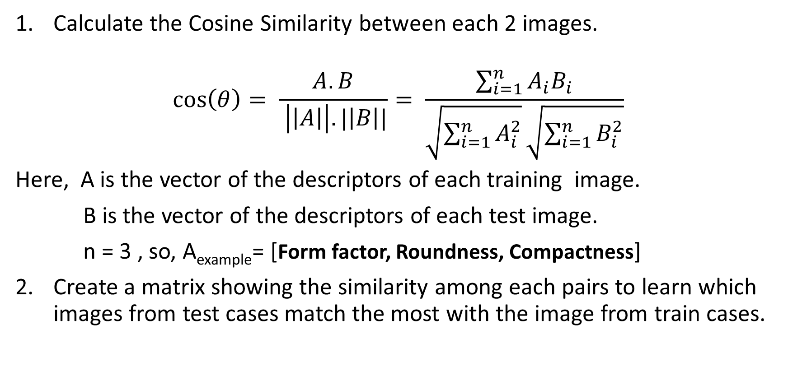
Similarity Measure
Calculate the Cosine Similarity between each 2 images.
$$\cos\left(θ\right)= \frac{A.B}{ \left|\left|A\right|\right|.|\left|B\right||}= \frac{\sum_{i=1}^{n}{A_{i}B_{i}}}{\sqrt{\sum_{i=1}^{n}{A_{i}^{2}}}\sqrt{\sum_{i=1}^{n}{B_{i}^{2}}}}$$
Here, A is the vector of the descriptors of each training image.
B is the vector of the descriptors of each test image.
n = 3 , so, A_{example}= [Form factor, Roundness, Compactness]
Create a matrix showing the similarity among each pairs to learn which images from test cases match the most with the image from train cases.

Slide 11




 | GT1 | GT2 | GT3
Test 1 | 1 | 0.99999 | 0.99995
Test 2 | 0.99998 | 1 | 0.999954
Test 3 | 0.999636 | 0.99962 | 0.999841
Test 4 | 0.999999 | 0.999999 | 0.999942

